Slide 1

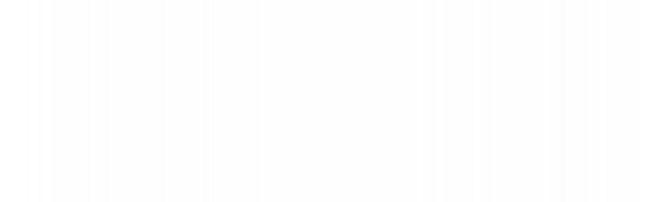

UNIVERSITY INSTITUTE OF ENGINEERING
COMPUTER SCIENCE ENGINEERING
Bachelor of Engineering
Design and Analysis of Algorithms(CST-311/ITT-311)
Topic: Greedy method, Fractional Knapsack
DISCOVER . LEARN . EMPOWER

Slide 2
Learning Objectives & Outcomes
Objective:
To understand the concept Greedy method and fractional knapsack problem solved by using greedy method.
Outcome:
Student will understand
Greedy method
Fractional Method

Slide 3
Greedy Method
Among all the algorithmic approaches, the simplest and straightforward approach is the Greedy method. In this approach, the decision is taken on the basis of current available information without worrying about the effect of the current decision in future.
Greedy algorithms build a solution part by part, choosing the next part in such a way, that it gives an immediate benefit. This approach never reconsiders the choices taken previously. This approach is mainly used to solve optimization problems.
Greedy method is easy to implement and quite efficient in most of the cases. Hence, we can say that Greedy algorithm is an algorithmic paradigm based on heuristic that follows local optimal choice at each step with the hope of finding global optimal solution.
In many problems, it does not produce an optimal solution though it gives an approximate (near optimal) solution in a reasonable time.

Slide 4
All greedy algorithms follow a basic structure:
getOptimal(Item, arr[], int n)
1) Initialize empty result : result = {}
2) While (All items are not considered)
// We make a greedy choice to select
// an item.
i = SelectAnItem()
// If i is feasible, add i to the
// result
if (feasible(i))
result = result U i
3) return result

Slide 5
Components of Greedy Algorithm
Greedy algorithms have the following five components −
A candidate set − A solution is created from this set.
A selection function − Used to choose the best candidate to be added to the solution.
A feasibility function − Used to determine whether a candidate can be used to contribute to the solution.
An objective function − Used to assign a value to a solution or a partial solution.
A solution function − Used to indicate whether a complete solution has been reached.

Slide 6
Areas of Application
Greedy approach is used to solve many problems, such as
Finding the shortest path between two vertices using Dijkstra’s algorithm.
Finding the minimal spanning tree in a graph using Prim’s /Kruskal’s algorithm, etc.

Slide 7
Where Greedy Approach Fails
In many problems, Greedy algorithm fails to find an optimal solution, moreover it may produce a worst solution. Problems like Travelling Salesman and Knapsack cannot be solved using this approach.

Slide 8
Fractional Knapsack
The Greedy algorithm could be understood very well with a well-known problem referred to as Knapsack problem. Although the same problem could be solved by employing other algorithmic approaches, Greedy approach solves Fractional Knapsack problem reasonably in a good time.

Slide 9
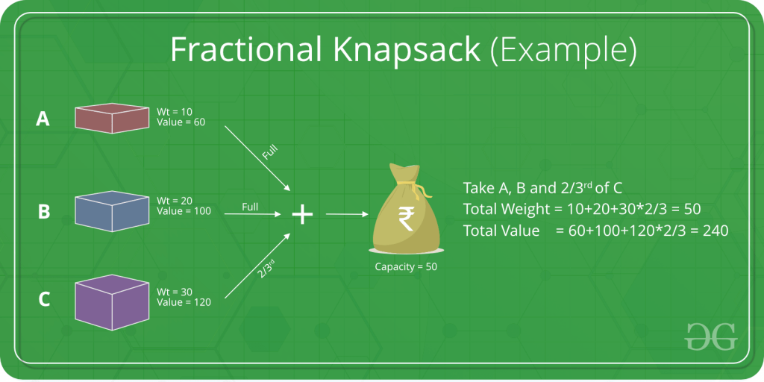

Slide 10
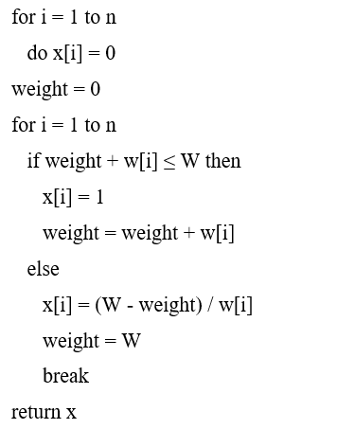
Algorithm
Algorithm: Greedy-Fractional-Knapsack (w[1..n], p[1..n], W)

Slide 11

Analysis

Slide 12
REFERENCES
Text books:
Cormen, Leiserson, Rivest, Stein, “Introduction to Algorithms”, Prentice Hall of India, 3rd edition 2012. problem, Graph coloring.
Websites:
https://www.tutorialspoint.com/design_and_analysis_of_algorithms/design_and_analysis_of_algorithms_fractional_knapsack.htm
https://www.geeksforgeeks.org/greedy-algorithms-general-structure-and-applications/
https://www.geeksforgeeks.org/greedy-algorithms/

Slide 13
Summary
    Greedy Method:
        Concept of Greedy Method
        Fractional Knapsack

Slide 14
THANK YOU

